Slide 1
Spin Dependent Proton Noise
Yuguang Tong,
Marc Pulupa,
Chadi Salem,
Stuart Bale

Slide 2
Motivation
Wind/WAVES TNR is well designed for thermal noise analysis:
Long dipole antenna (100m tip to tip)
Thin wire (.19mm radius)
High resolution ( usually 4.4s, 4% log scale in frequency)
Initial goal to study cold electrons in magnetic cloud.
My code too slow to do any fit.
Calculate QTN using Wind/3DP parameters (Salem & Pulupa)
Calculate QTN using two-Maxwellian electron parameters from QTN fitting (Perche & Salem)
Notes:
Comparable or dominates the in a range below plasma frequency.
Doppler shift not easily tractable.

Slide 3
Motivation
Observations:
1, When TNR spectra look nice, the band C and E are smoother than A. Band A even seem to have some structure. Is it purely statistical?
2, In both comparisons, good agreement for the peak and above fp.
Often not good agreement in the low frequency (band A).
(show plots)
Notes:
Comparable or dominates the in a range below plasma frequency.
Doppler shift not easily tractable.

Slide 4
Ion noise (review)
(Issautier et al. 1999)
Antenna power spectrum when plasma drifts at V:
Stand assumption: linear current
angle [k, ant]
angle [V, ant]

Slide 5
Ion noise (review cont.)
Then with clever use of Kramers-Kronig relation, we reduce the theta integral and get rid of the possibly singular integrand.
=> 2D integral in k and phi respectively.
Notes:
Comparable or dominates the in a range below plasma frequency.
Doppler shift not easily tractable.

Slide 6
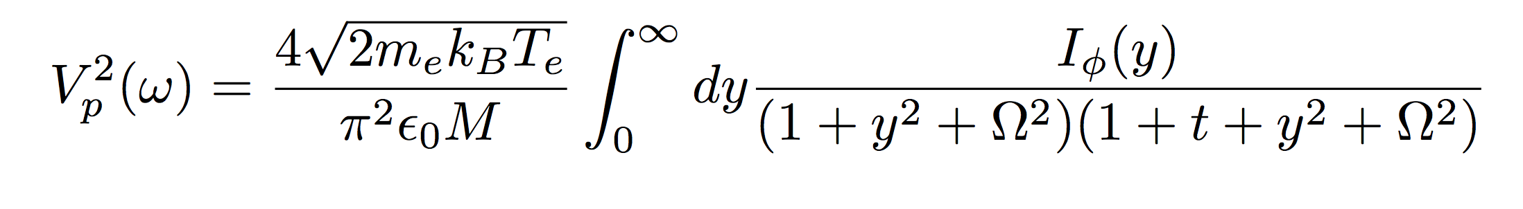
Ion noise: release the constraint on angle
(Tong et al. 2015)
Notes:
Comparable or dominates the in a range below plasma frequency.
Doppler shift not easily tractable.

Slide 7
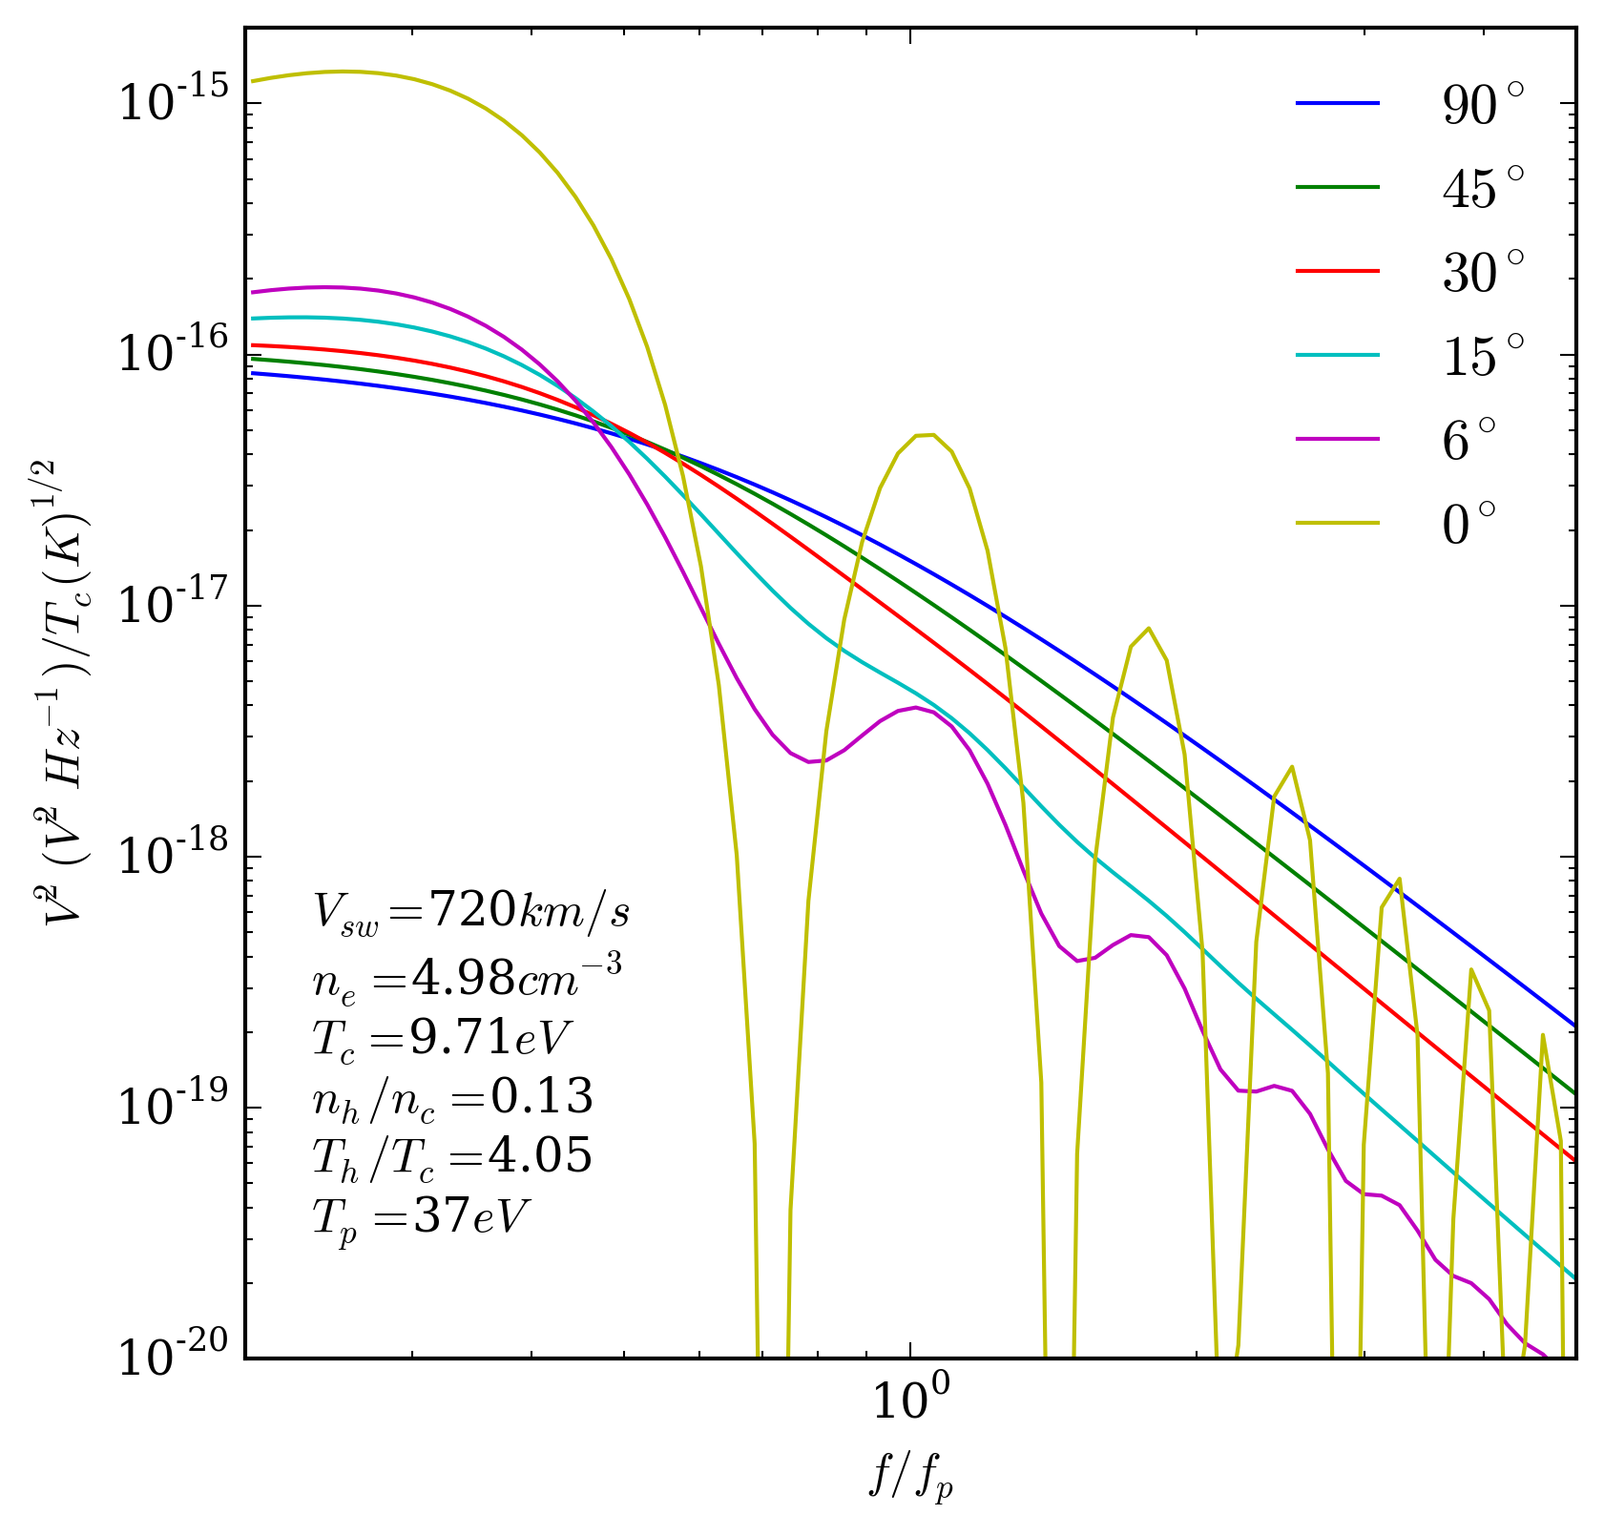
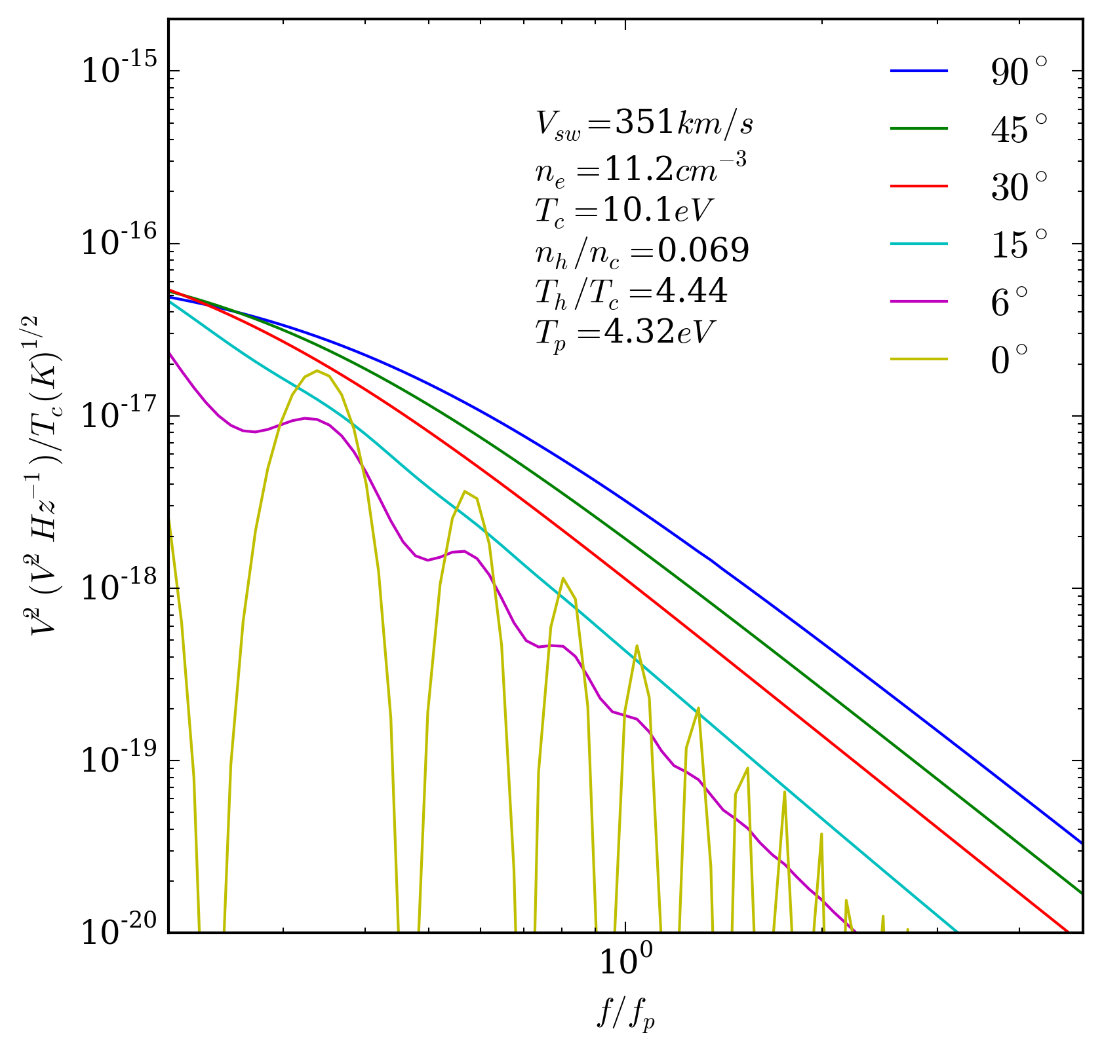
Angular dependence of ion noise
Strong dependence of angle [V, ant]. Also dependence on Tp, Tc, V.
Notes:
Comparable or dominates the in a range below plasma frequency.
Doppler shift not easily tractable.

Slide 8
Case study: 1995 June 19
Quiet solar wind with well identifiable plasma peak. Contains both fast wind and slow wind
Electron density and temperature are obtained by least square fit to TNR spectra.
  Assumes two isotropic Maxwellian electron populations (core and halo).
  Assumes that antenna is perpendicular to the solar wind velocity.
Notes:
Comparable or dominates the in a range below plasma frequency.
Doppler shift not easily tractable.

Slide 9
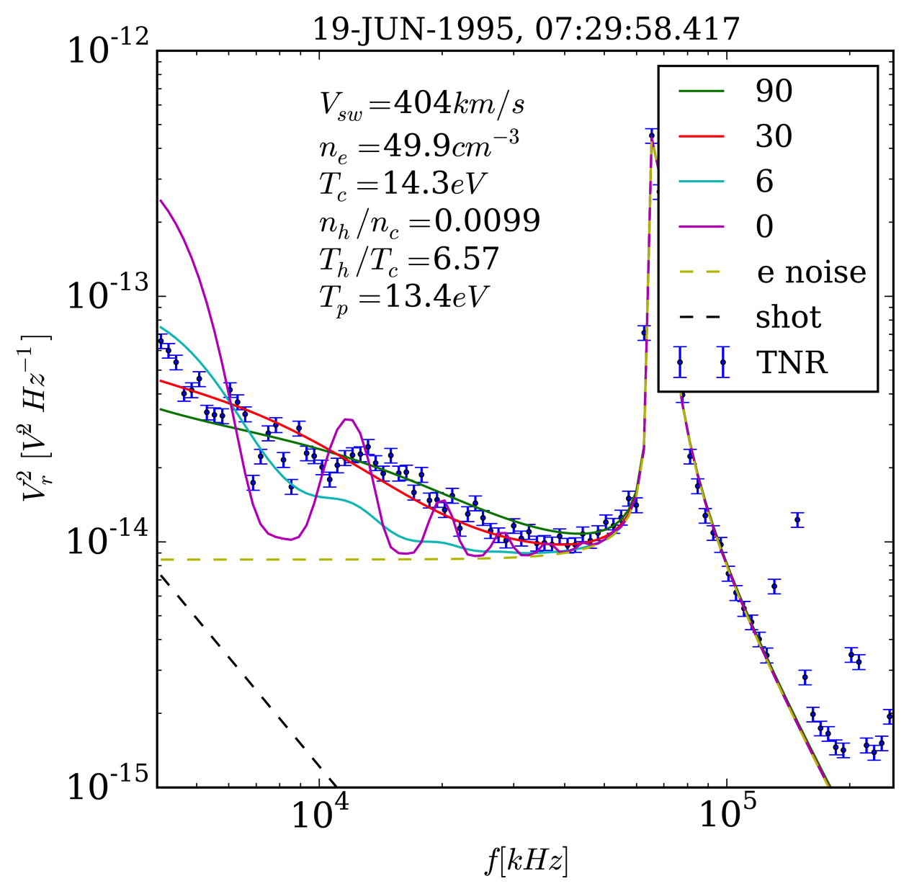
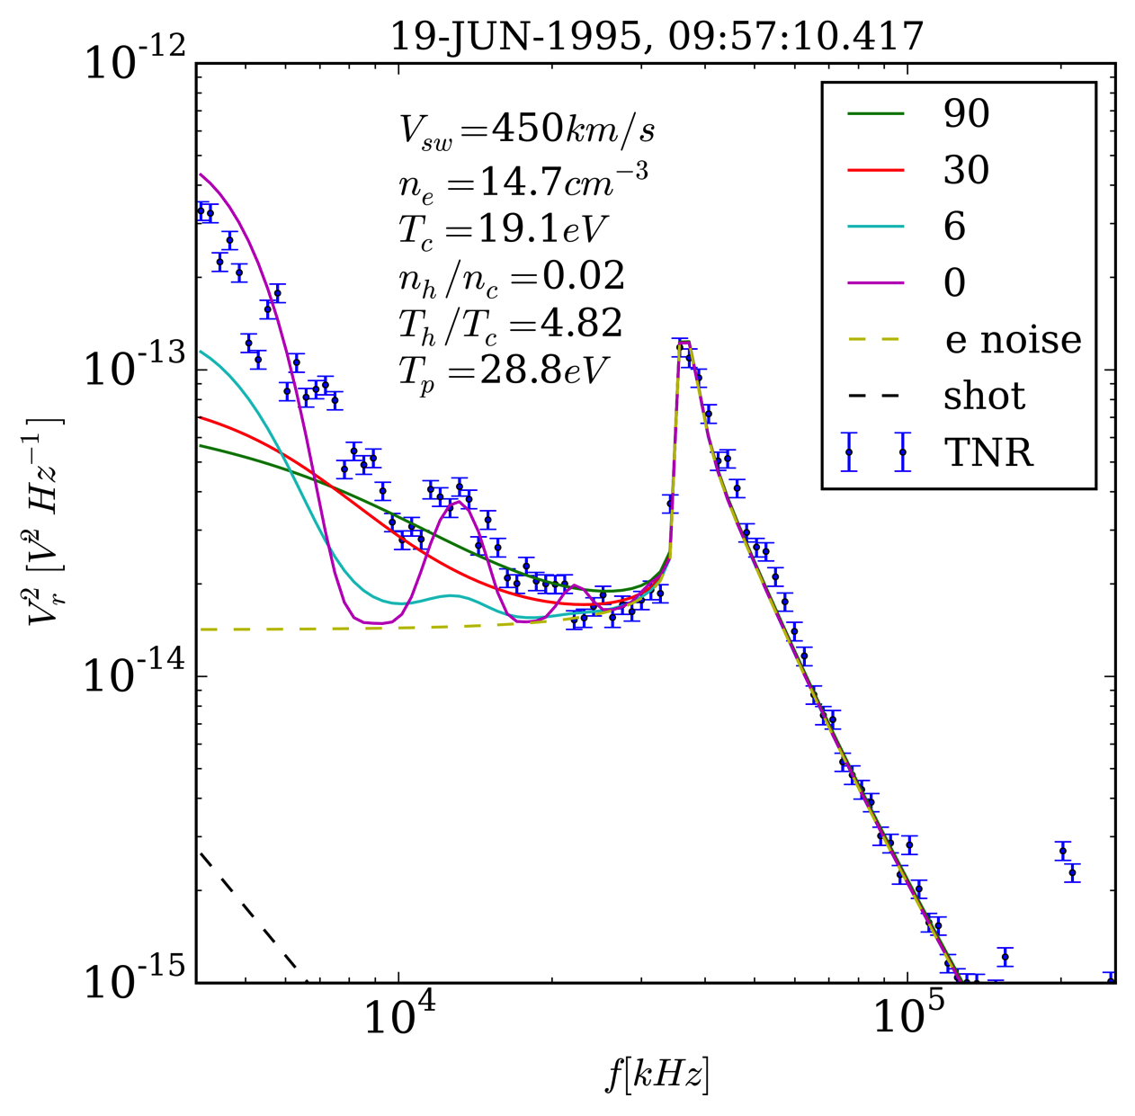
Case study: 1995 June 19
Two examples of slow wind.
Notes:
Comparable or dominates the in a range below plasma frequency.
Doppler shift not easily tractable.

Slide 10
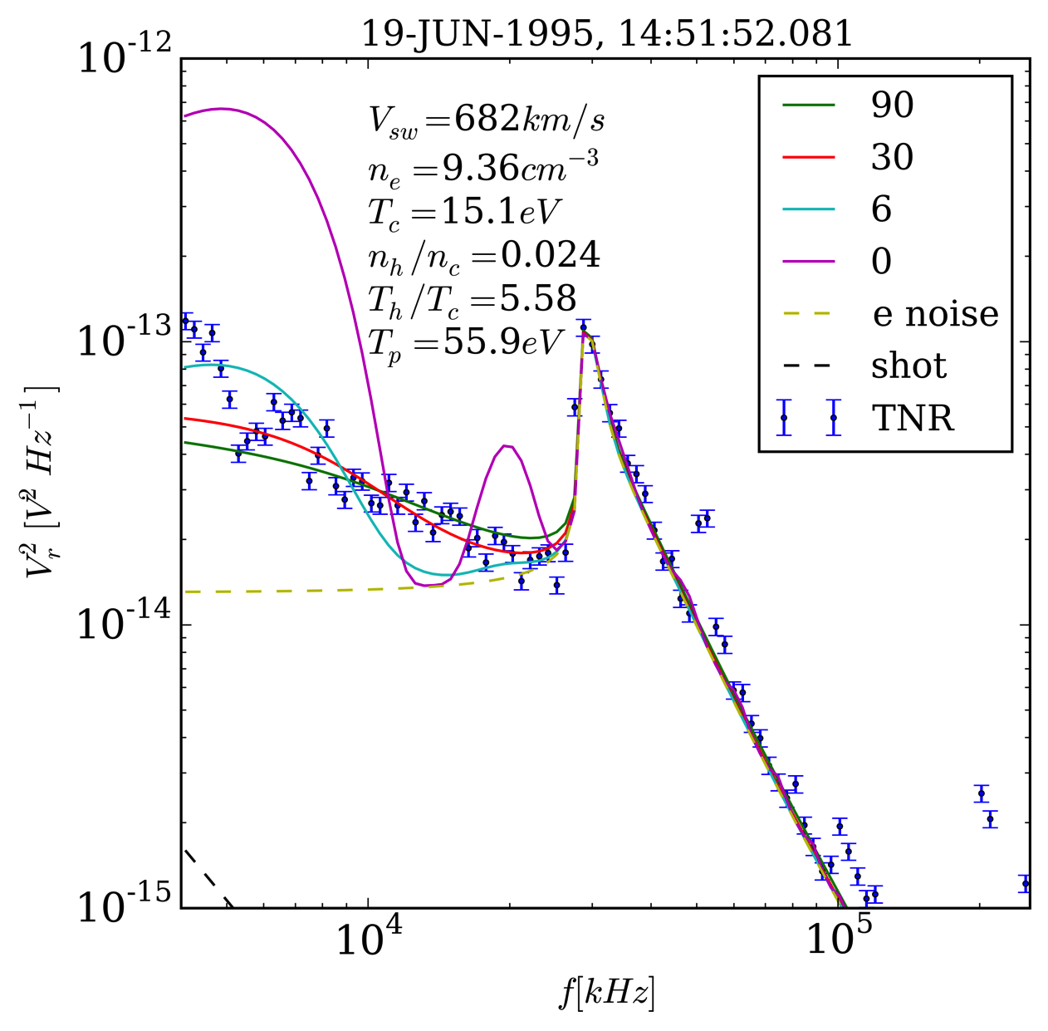
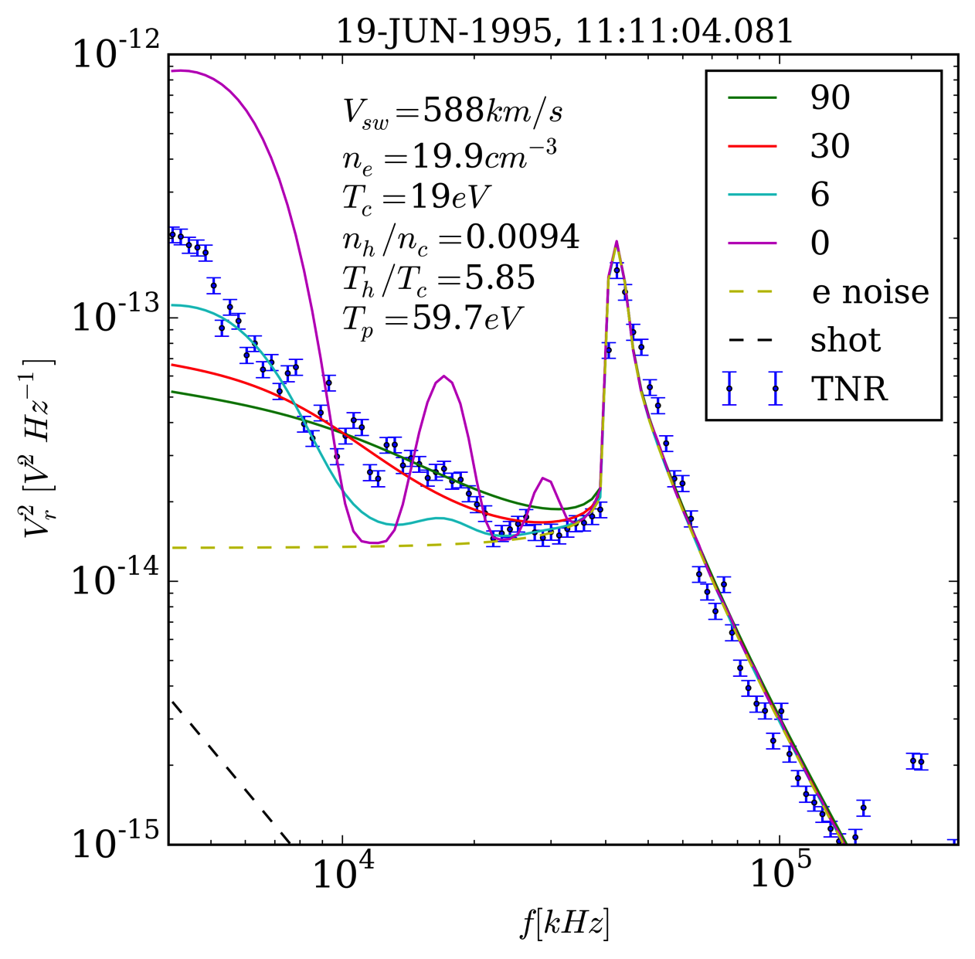
Case study: 1995 June 19
Two examples of fast wind.
Notes:
Comparable or dominates the in a range below plasma frequency.
Doppler shift not easily tractable.

Slide 11
Discussion
Can we go beyond the qualitative argument on the agreement of the range?
Angular position can be pinned down (at the start of the event). But data does not agree with a single angle nor the average. How was data acquired and processed?
Solar Probe Plus:
S/C has large tangential speed in close pass by.
Comparable to Vsw.
No expect to see very small angle [Vsw, ant].
Antenna is short and not as thin as Wind. Shot noise may be important too.
Notes:
Comparable or dominates the in a range below plasma frequency.
Doppler shift not easily tractable.

Slide 12
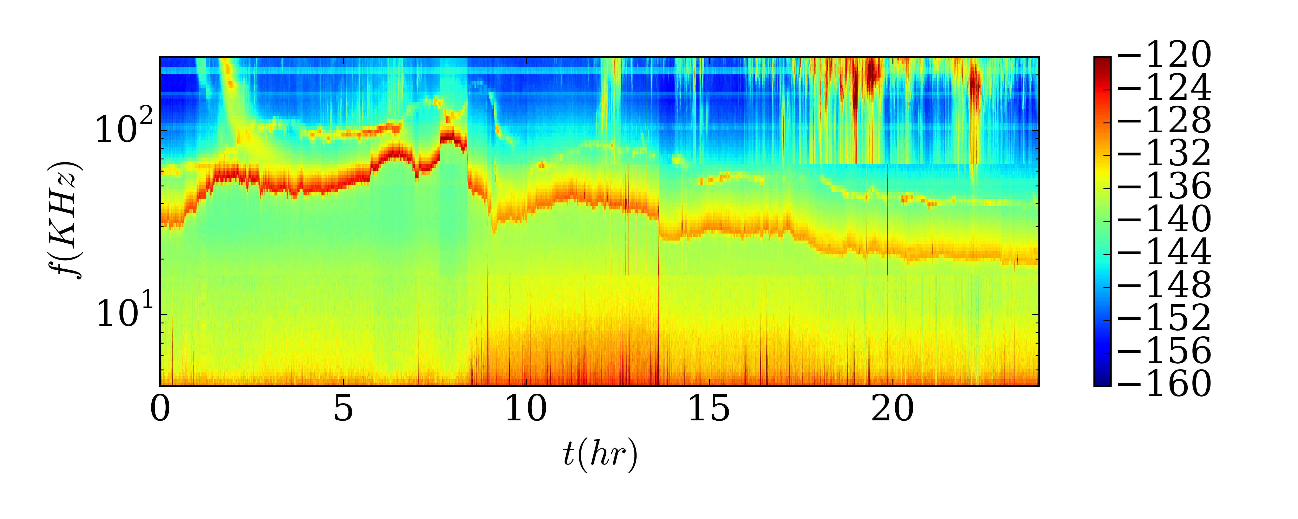
Discussion: ion acoustic wave?
Doppler shifted ion acoustic wave?
Mangeney et al 1999, Chadi PhD thesis
Notes:
Comparable or dominates the in a range below plasma frequency.
Doppler shift not easily tractable.

Slide 13
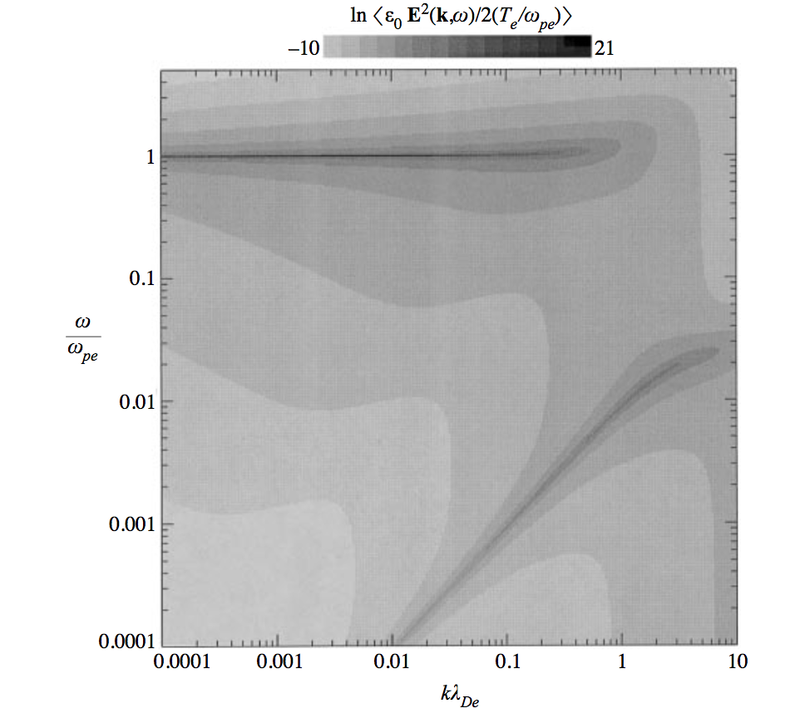
Discussion: ion acoustic wave?
(Mace, Hellberg & Truemann 1998)
Notes:
Comparable or dominates the in a range below plasma frequency.
Doppler shift not easily tractable.

Slide 14
Conclusion
We develop a more tractable expression for ion noise for the case of arbitrary angle [V, ant].
We show that the ion noise strongly depends on the angle, which may be important for QTN fitting. We also discuss the implication for SPP.
We discuss the relation of the ion noise and ion acoustic waves.
Notes:
Comparable or dominates the in a range below plasma frequency.
Doppler shift not easily tractable.

